Slide 1



DEPARTMENT OF ELECTRONICS AND COMMUNICATION ENGINEERING
PRESENTATION DAY - 2
n RFID Technology and Applications
PRESENTED BY
1.SARAN S [927621BEC184]
2.SANJAI B [927621BEC176]
3.SATHOSH KUMAR S [927621BEC182]
4. SANGEETH KUMAR R [927621BEC173]
Guided By:
Dr .M. Dhamodaran
AP/ECE
MKCE
27/01/2023

Slide 2
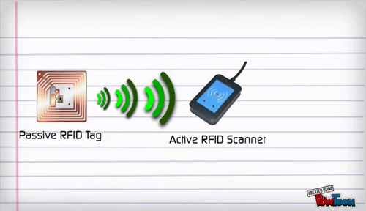
What is RFID?
Radio Frequency Identification (RFID) refers to a wireless system comprised of two components: tags and readers.
The reader is a device that has one or more antennas that emit radio waves and receive signals back from the RFID tag..
MKCE
27/01/2023

Slide 3

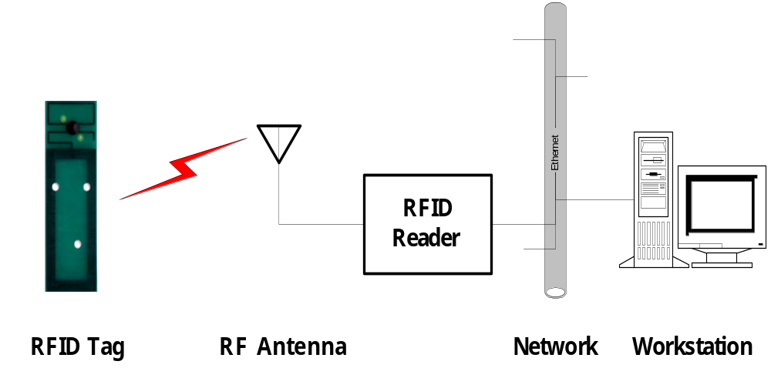
RFID system components
MKCE
27/01/2023

Slide 4
RFID tags
Passive Tags
  Do not require power – Draws from Interrogator Field
  Lower storage capacities (few bits to 1 KB)
  Shorter read ranges (4 inches to 15 feet)
  Usually Write-Once-Read-Many/Read-Only tags
  Cost around 25 cents to few dollars
Active Tags
  Battery powered
  Higher storage capacities (512 KB)
  Longer read range (300 feet)
  Typically can be re-written by RF Interrogators
  Cost around 50 to 250 dollars
MKCE
27/01/2023

Slide 5
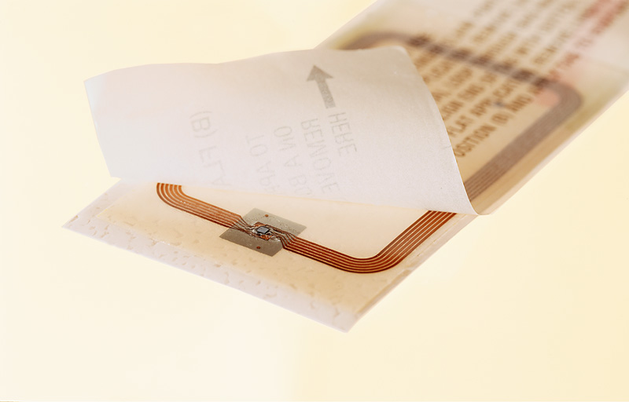
RFID tags: Smart labels
A paper label
with RFID inside
an antenna,
printed, etched
or stamped ...
… and a chip
attached to it
… on a substrate
e.g. a plastic
foil ...
MKCE
27/01/2023
Source: www.rfidprivacy.org

Slide 6
Tag block diagram
Antenna
Power Supply
Memory
Cells
Control Logic
(Finite State machine)
Tx Modulator
Rx Demodulator
Tag Integrated Circuit (IC)
MKCE
27/01/2023

Slide 7
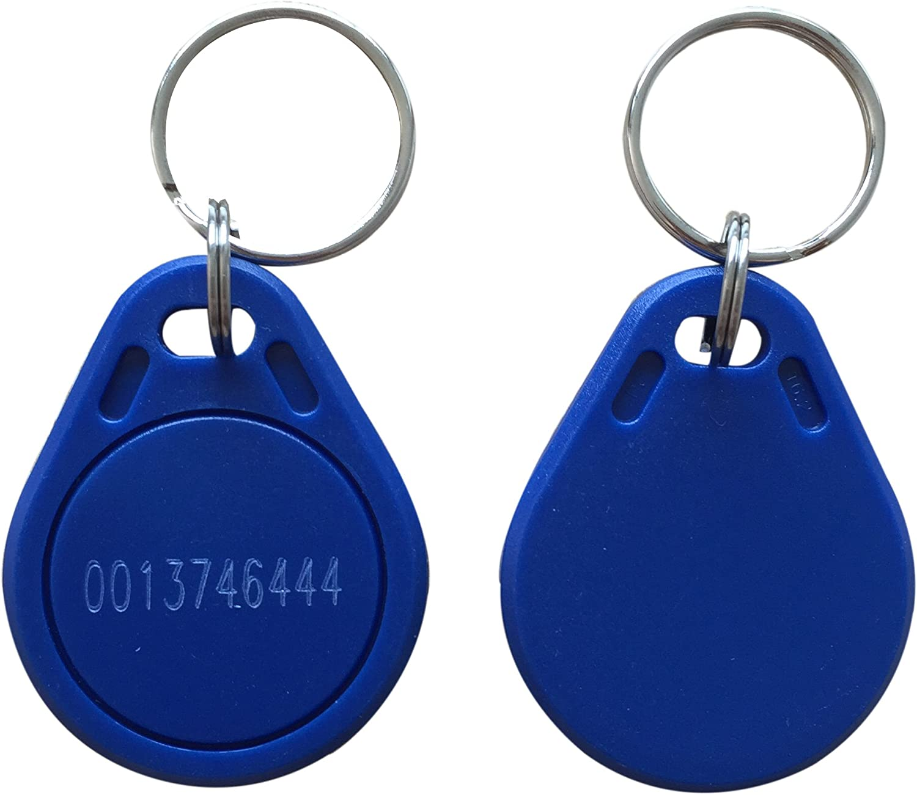
RFID tag memory
Read-only tags
Write once, read many (WORM) tags
Read/Write

Slide 8
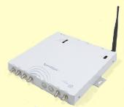
RFID readers
Reader functions:
  Remotely power tags
  Establish a bidirectional data link
  Inventory tags, filter results
  Communicate with networked server(s)
  Can read 100-300 tags per second
Readers (interrogators) can be at a fixed point such as
  Entrance/exit
  Point of sale
Readers can also be mobile/hand-held
MKCE
27/01/2023

Slide 9






RFID communications
Reader
Antenna
Power from RF field
Reader->Tag Commands
Reader
Tag->Reader Responses
Tags
RFID Communication Channel
MKCE
27/01/2023

Slide 10
Antenna fields: Inductive coupling
IC or microprocessor
RFID
Tag
Transceiver
Tag Reader
antenna
antenna
MKCE
27/01/2023

Slide 11
Antenna fields: Propagation coupling
IC or microprocessor
RFID
Tag
Transceiver
Tag Reader
antenna
antenna
MKCE
27/01/2023

Slide 12



Reader->Tag power transfer
Reader
Antenna
Tag
Reader
Separation
distance d
Q: If a reader transmits Pr watts, how much power Pt does the tag receive at a separation distance d?
A: It depends-
UHF (915MHz) : Far field propagation : Pt ∝ 1/d²
HF (13.56MHz) : Inductive coupling : Pt ∝1/d⁶
MKCE
27/01/2023

Slide 13

RFID application points
Assembly Line
Wireless
Handheld Applications
Bill of Lading
Material Tracking
Shipping Portals
MKCE

Slide 14
RFID advantages over bar-codes
No line of sight required for reading
Multiple items can be read with a single scan
Each tag can carry a lot of data (read/write)
Individual items identified and not just the category
Passive tags have a virtually unlimited lifetime
Active tags can be read from great distances
Can be combined with barcode technology
MKCE
27/01/2023

Slide 15
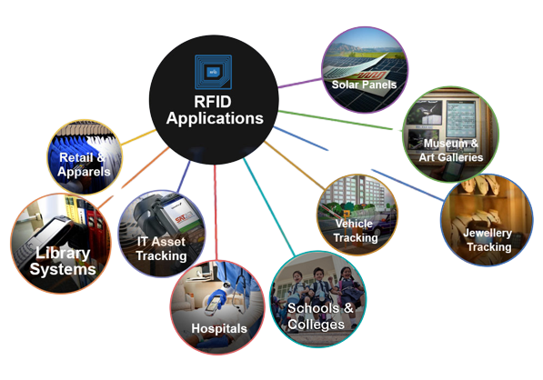
Applications of RFID
MKCE
27/01/2023

Slide 16
RFID Advantages
Speed and Convenience
Wider Range
Simultaneous Scanning
Data Security
Versatility
MKCE
27/01/2023

Slide 17
RFID Disadvantages
Technological Competency
Relatively Costlier
Scanning Issues
Privacy Concerns
Inferiority
MKCE
27/01/2023

Slide 18

MKCE
27/01/2023

